Slide 1


VISVESVARAYA TECHNOLOGICAL UNIVERSITY BELAGAVI -590018
Smt. Kamala & Sri. Venkappa M Agadi College of Engineering & Technology,Laxmeshwar-582116
(Approved by AICTE, New Delhi & Affiliated to VTU Belagavi, ISO 9001:2015 Certified)
Department Of Information Science and Engineering
PREDICTION OF HEART DISEASE USING RETINAL IMAGES
Under the Guidance
Dr. Rajshekhar Kunabeva
Name
USN
Anusha Gaddi
2KA20IS007
Dhanvantri Kulkarni
2KA20IS009
Sukruta Thogarcheti
2KA20IS032
Sunita Totakar
2KA21IS400

Slide 2
CONTENTS
INTRODUCTION
LITERATURE SURVEY
PROBLEM STATEMENT
OBJECTIVES
FUNCTIONAL AND NON FUNCTIONAL SPECIFICATION
SYETEM REQUIREMENT SPECIFICATION
METHODOLOGY
SYSTEM IMPLEMENTATION
TESTING
RESULTS
CONCLUSION
REFERENCES
2

Slide 3
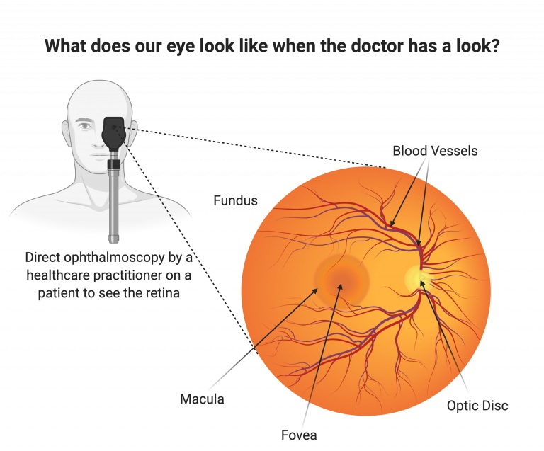
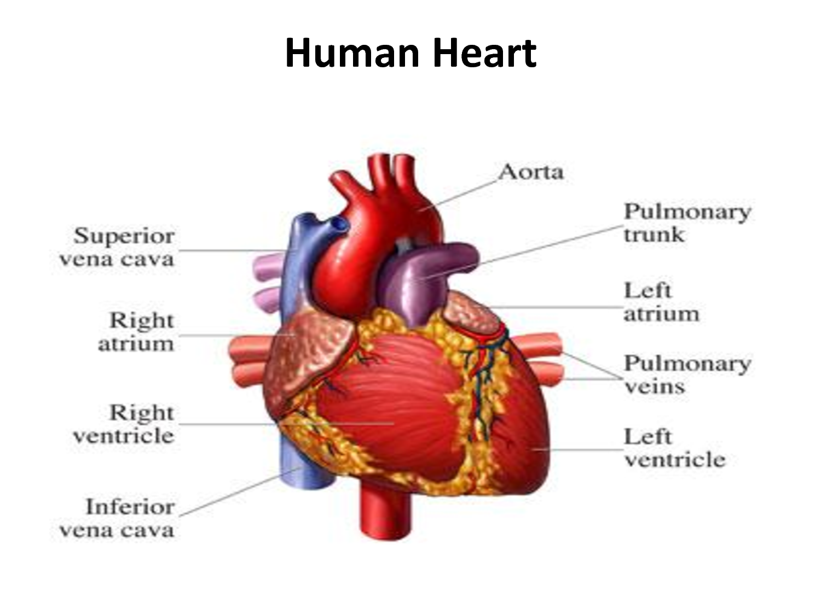
INTRODUCTION
3
Day by day the cases of heart diseases are increasing at a rapid rate and it’s very Important and concerning to predict any such diseases beforehand.
This diagnosis is a difficult task i.e. it should be performed precisely and efficiently.
A quite helpful approach was used to regulate how the model can be used to improve the accuracy of prediction of Heart Attack in any individual.
Fig 1:Overview of retina
Fig 2:Overview of Human Heart

Slide 4
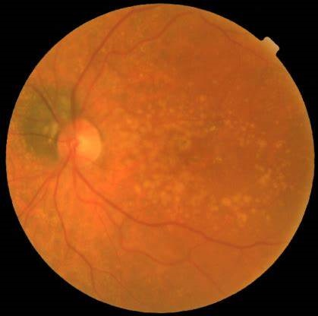
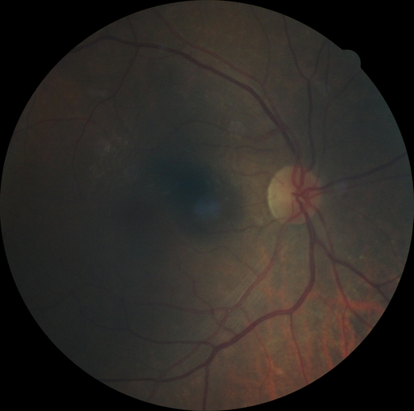
4
Fig 3:Retina of a healthy person
Fig 4:Retina of person with high risk of heart disease

Slide 5
LITERATURE SURVEY
S.No | Author | Paper Name | Year | Limitations
1 | Henner Hanssen, Lukas Streese, Walthard Vilser | Retinal vessel diameters and function in cardiovascular risk and disease. | June-22 | It was noted that retinal FID may also be impaired in patients having eye disease (glaucoma) systemic neurological disease(Alzheimer, Multiple Sclerosis).
2 | Shukai Liu , Rebecca L.Thomas , David R.Owens | Risk Assessment of CHD Using Retinal Images with Machine Learning Approaches for People with Cardiometabolic Disorders. Accuracy 92.6% | May-22 | Although the retinal images were captured prospectively, this is still a retrospective study since CHD patients may have their disease developed when admitted to the hospital.
3 | Rubén G. Barriada , David Masip | An Overview of Deep-Learning-Based Methods for Cardiovascular Risk Assessment with Retinal Images. Accuracy 78.3% | Dec-22 | Some of the works reviewed here had considerably large image datasets, data accessibility is still very limited.

Slide 6
PROBLEM STATEMENT
6
To predict the risk of heart attack using retinal images with help of machine learning algorithms.
OBJECTIVES
The main objective of this research is to develop a prototype Intelligent Heart Disease Prediction System (IHDPS) using machine learning algorithms.
To use the retinal fundus images more consistently to predict the risks factors at early stages.

Slide 7
FUNCTIONAL AND NON -FUNCTIONAL SPECIFICATIONS
7
1. Funtional Specifications
DNN classification and logistic regression.
Clustering of input data.
Predicting heart disease risk level.
Predicting the age, SBP, DBP, BMI and haemoglobin level.
Plotting the accuracy of testing and training datasets.
Plotting different features casued heart attack.

Slide 8
2.Non-Funtional Specifications
Reliability
Maintainability
Supportability
Usability
Producibility
Disposability,
Sustainability
Affordability

Slide 9
SYSTEM REQUREMENT SPECIFICATION
8
1: Hardware requirement
Hard Disk: Greater than 15GB
RAM: Greater than 1GB
Processor: Core 2 Duo and Above
2: Software Requirement
MS Windows
Python
Aanconda IDE
Flask

Slide 10
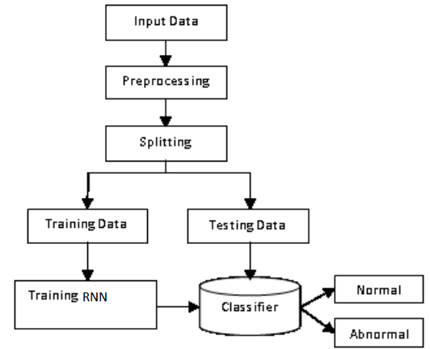
METHODOLOGY
9
1: Block Diagram
Fig 5: Block Diagram

Slide 11
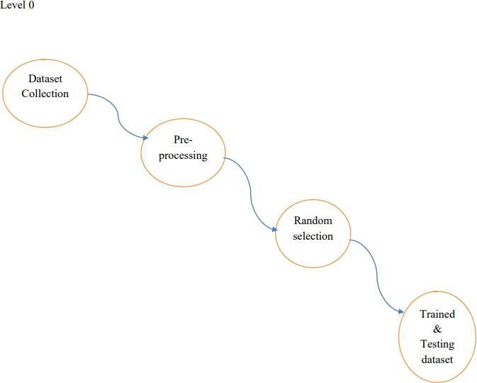
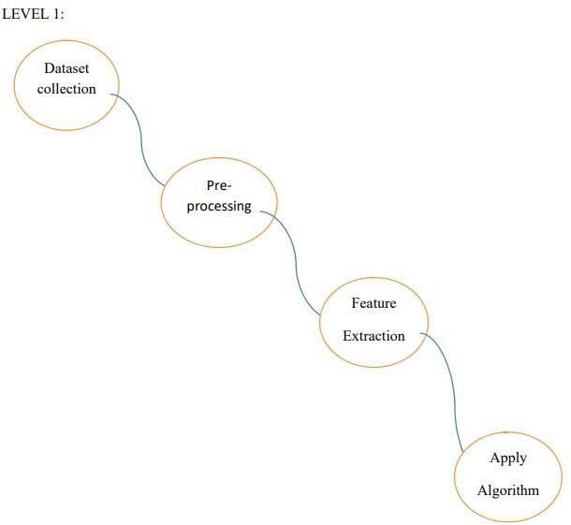
2:Dataflow Diagram
10
Fig 6:Level 0 dataflow diagram
Fig 7:Level 1 dataflow diagram

Slide 12
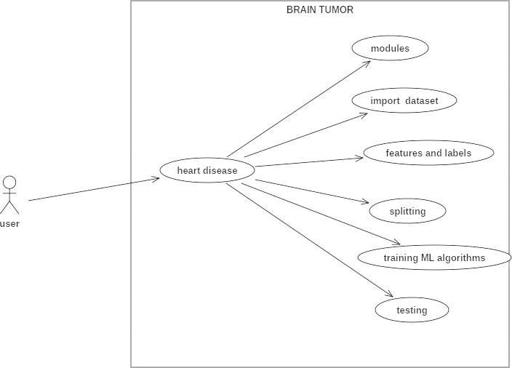
3:Usecase Diagram
11
Fig 8: Usecase Diagram

Slide 13
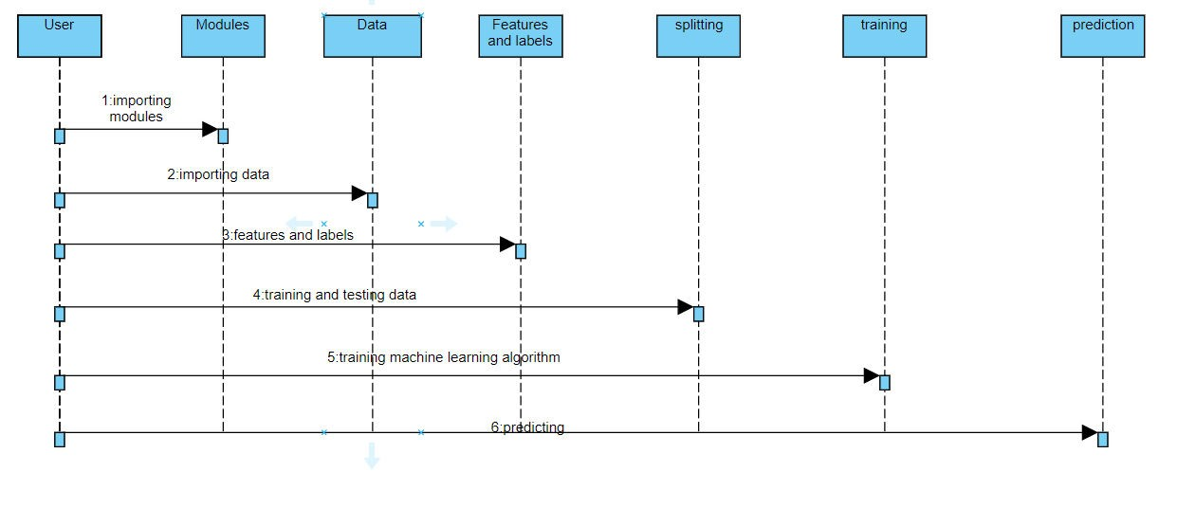
5:Sequence Diagram
12
Fig 9: Sequence Diagram

Slide 14
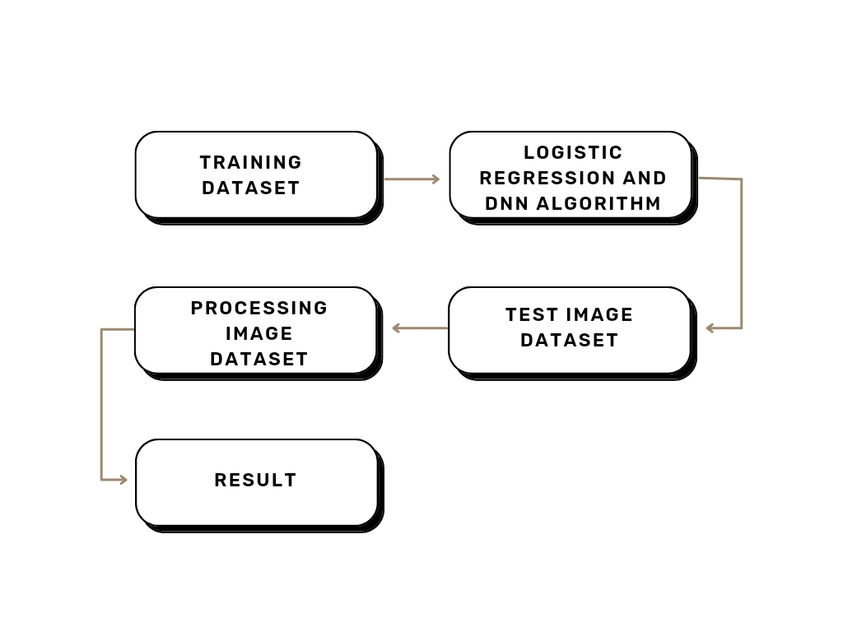
System Implementation
Fig 10:System Implementation flow chart

Slide 15
TESTING
14
1:Unit Testing
Unit testing is usually conducted as part of a combined code and unit test phase of the software lifecycle, although it is not uncommon for coding .
2:Integration Testing
Software integration testing is the incremental integration testing of two or more integrated software components on a single platform to produce failures caused by interface defects.The task of the integration test is to check that components or software applications, e.g. components in a software system or – one step up – software applications at the company level – interact without error.
3:Acceptance Testing
User Acceptance Testing is a critical phase of any project and requires significant participation by the end user. It also ensures that the system meets the functional requirements.

Slide 16
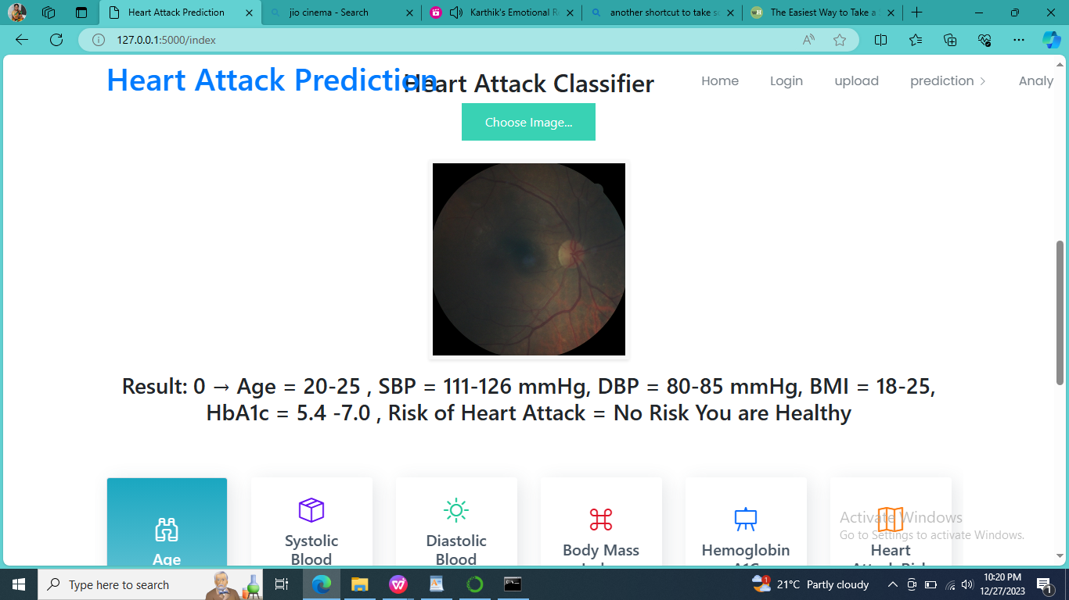
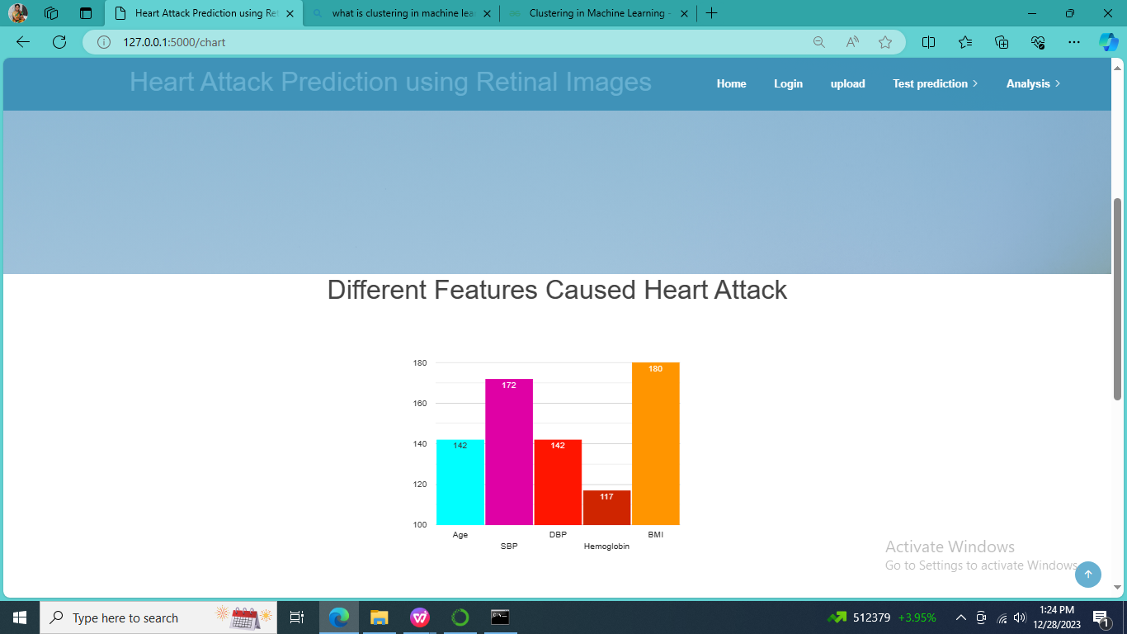
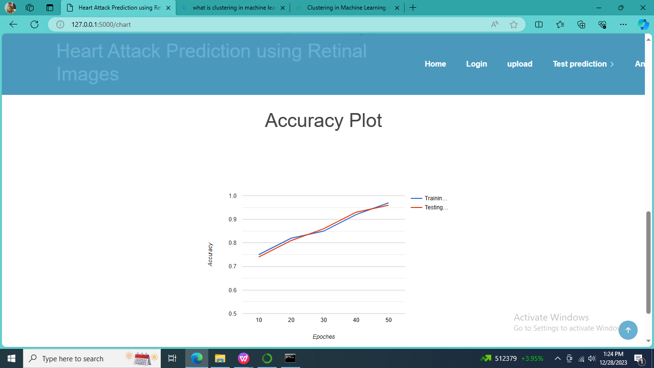
RESULTS
Fig 11:Output
Fig 12:Plot of different features caused heart attack
Fig 13:Accuracy plot

Slide 17
Datasets | Age | Systolic Blood Pressure | Diastolic Blood Pressure | Body Mass Index | Hemoglobin A1C | Heart Attack Risk
10_left | 20-25 | 111-126 mmHg | 80-85 mmHg | 18-25 | 5.4 -7.0 | No Risk You are Healthy
1077_right | 30-35 | 140-160 mmHg, | 80-90 mmHg | 27-29, | 4-5.6 | Very Low Risk 20%
10454_right | 45-60 | 160-176 mmHg | 95-100 mmHg, | 30-35, | 13.4 -14.9 | High Chance of Heart Attack 60%
1088_right | 35-40 | 120-136 mmHg | 75-55 mmHg | 18-25 | 5.5 -6.5 | No Risk You are Healthy
11854_right | 45-60 | 160-176 mmHg | 95-100 mmHg | 30-35 | 13.4 -14.9 | High Chance of Heart Attack 60%
1178_right | 30-35 | 140-160 mmHg | 80-90 mmHg | 27-29 | 4-5.6 | Very Low Risk 20%
10321_left | 45-60 | 160-176 mmHg | 95-100 mmHg | 30-35, | 13.4 -14.9 | High Chance of Heart Attack 60%
16
Fig 14:Table for result output

Slide 18
CONCLUSION
17
Identifying the processing of raw healthcare data of heart information will help in the long term saving of human lives and early detection of abnormalities in heart conditions.Machine learning techniques were used in this work to prcess the raw data and provide a new and novel discernment towards heart disease.Heart disease prediction is challenging and very important in the medical.However, the mortality rate can be drastically controlled if the disease is detected at the early stages and preventative measures are adopted as soon as possible.Further extension of this study is highly desirable to direct the investigations to real-world datasets instead of just theorectical approaches and simulations.

Slide 19
REFERENCES
Pampana LK, Rayudu MS. A review: prediction of multiple adverse health conditions from retinal images. In: 2020 IEEE Bangalore humanitarian technology conference (B-HTC). IEEE; 2020.
Liu Z, et al. Swin transformer: hierarchical vision transformer using shifted windows. In: Proceedings of the IEEE/CVF international conference on computer vision; 2021.
Gopinath B, et al. Retinal vascular geometry and the prevalence of atrial fibrillation and heart failure in a clinic-based sample. Heart Lung Circ 2019
18

Slide 20
THANK YOU
19

